Slide 1

Artificial Intelligence in Education
Made By
Swastik Mallick

Slide 2

INTRODUCTION
Artificial intelligence (AI) is rapidly reshaping the educational landscape, introducing unprecedented opportunities to enhance learning, expand accessibility, and streamline administrative processes. With its ability to tailor education to individual needs and automate repetitive tasks, AI offers a promising future for both educators and learners.

Slide 3

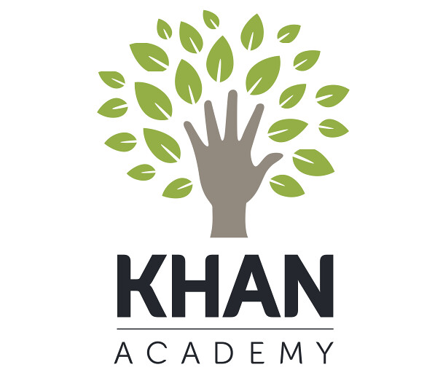
Personal System
AI has been steadily integrating into education through tools like Duolingo, Khan Academy, and Microsoft Immersive Reader. These technologies leverage algorithms and data analysis to adapt to individual learning needs. For example, intelligent tutoring systems provide real-time feedback to students, creating a more interactive learning experience. But these tools are not new; their evolution has made education more efficient and accessible over the years.

Slide 4
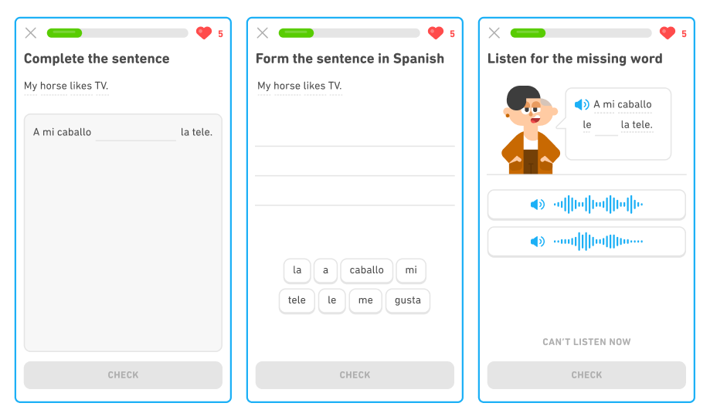
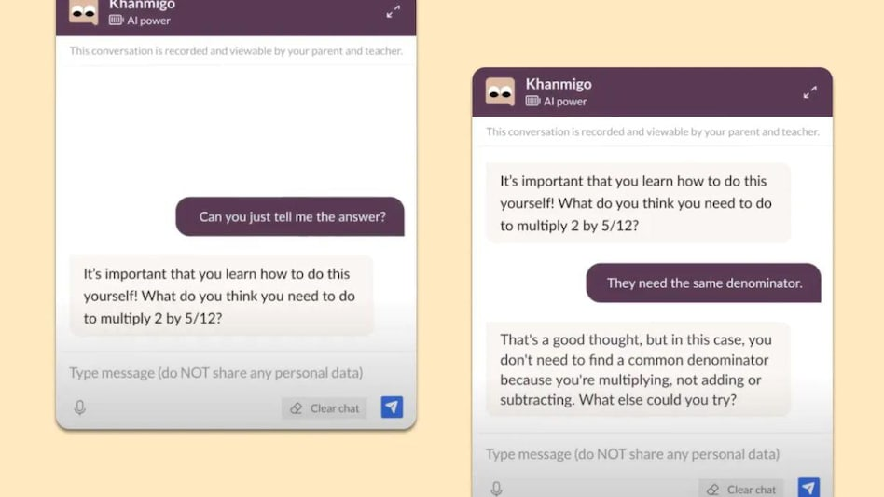
Khan Academy
Duolingo

Slide 5
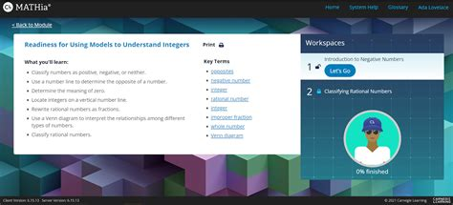
Intelligent Tutoring Systems
Intelligent Tutoring Systems, or ITS, go beyond traditional online learning by offering real-time, interactive feedback. For example, Carnegie Learning’s MATHia helps students master algebra with adaptive problem sets. Studies have shown that ITS can significantly improve student performance. Despite these advantages, ITS cannot replicate the emotional intelligence of human tutors, which is often vital in encouraging students to persist through challenges.
MATHia

Slide 6
Accessibility Tools
AI is also revolutionizing accessibility in education. Tools like Microsoft Immersive Reader simplify text for learners with dyslexia, and speech-to-text applications empower students with physical or visual impairments. For instance, a visually impaired student I interviewed excelled in an online coding course using screen-reading software. However, high costs and limited availability of these tools in underfunded schools mean many students miss out on these benefits. Addressing these inequities is critical.

Slide 7
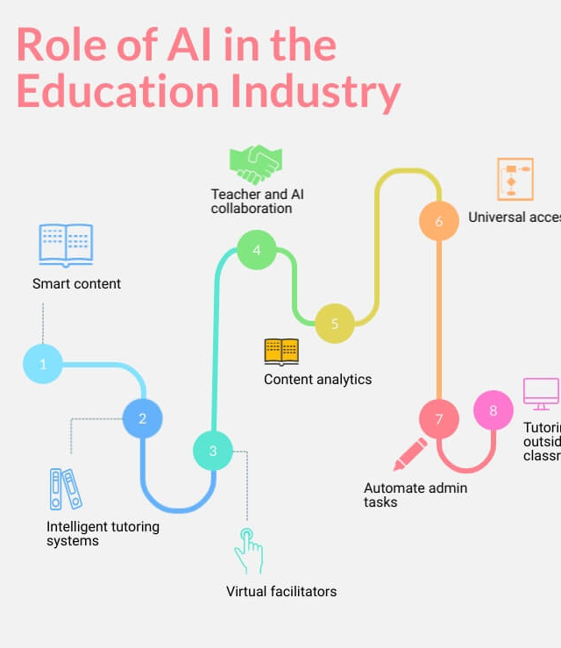
Administrative Applications
Beyond the classroom, AI streamlines administrative tasks. Automated grading tools like Gradescope save educators time, enabling them to focus on teaching and mentoring. AI can also manage attendance and scheduling with greater efficiency. However, these systems aren’t perfect. For example, automated grading often struggles with subjective assessments like essays. Human oversight remains necessary to ensure fairness and accuracy.

Slide 8
Ethical Concerns & Recommendation
While AI offers numerous benefits, it also raises significant ethical concerns. Data privacy is a major issue, as AI tools require extensive data collection. Algorithmic bias is another challenge; if AI systems are trained on biased datasets, they can perpetuate inequities. Additionally, there’s a digital divide—schools in low-income areas often lack the resources to adopt AI tools, leaving disadvantaged students further behind. Policymakers must prioritize equitable access to address these challenges.
To ensure the responsible adoption of AI, I recommend starting with pilot programs to identify strengths and areas for improvement before scaling up. Educators need training to effectively integrate AI tools into their teaching. Policies must ensure data privacy and equitable access, particularly in underfunded schools. By taking these steps, we can harness the benefits of AI while minimizing its risks.

Slide 9
Conclusion
In conclusion, AI holds immense potential to revolutionize education. From personalized learning to accessibility and administrative efficiency, its benefits are transformative. However, ethical and logistical challenges must be addressed. By adopting AI responsibly and equitably, we can create a future where technology complements traditional teaching methods, making education more inclusive, efficient, and effective.

Slide 10
Citations
Duolingo. How Duolingo Is Using Artificial Intelligence for Social Good. 30 Mar. 2023, blog.duolingo.com/ai-improves-education. Accessed 1 Dec. 2024.
Coursera. The History of AI: A Timeline of Artificial Intelligence. Oct. 2023, www.coursera.org/articles/history-of-ai. Accessed 1 Dec. 2024.
Getting Smart. New DreamBox Learning Feature Provides Personalized Learning Experiences. 29 Apr. 2016, www.gettingsmart.com/new-dreambox-learning-feature-provides-personalized-learning. Accessed 1 Dec. 2024.
Khan Academy. How We Built AI Tutoring Tools. 7 Mar. 2024, blog.khanacademy.org/how-we-built-ai-tutoring-tools. Accessed 1 Dec. 2024.
How-To Geek. How to Use Immersive Reader in Microsoft Word, Outlook, and OneNote. 15 Mar. 2021, www.howtogeek.com/how-to-use-immersive-reader-in-microsoft-tools. Accessed 1 Dec. 2024.
Someka. AI Flowchart | AI Workflow. 1 Jun. 2022, www.someka.net/templates/ai-workflow-templates. Accessed 1 Dec. 2024.
Cognilytica. Top 8 Ethical Concerns for AI. 16 Aug. 2018, www.cognilytica.com/top-8-ethical-concerns-for-ai. Accessed 1 Dec. 2024.
Techopedia. Transforming Education: AI-Powered Personalized Learning Revolution. 15 Jun. 2023, www.techopedia.com/transforming-education-ai-powered-personalized-learning-revolution. Accessed 1 Dec. 2024.

